Slide 1
SQL Server Security Design
CIS 483 – Database Security
Computer Information Systems
University of Louisville
Ghiyoung Im, PhD

Slide 2
Agenda
Principles of Database Security
Methodology for Designing a SQL Server Security Policy
Monitoring SQL Server Security

Slide 3
- The Microsoft Trustworthy Computing Initiative - Principle of Least Privilege - Common Criteria for IT Security Evaluation - C2 Auditing Requirements
Principles of Database Security

Slide 4
Microsoft Trustworthy Computing Initiative
Principle | Description
Security | The ability of the security system to protect against attacks and secure the integrity of information
Privacy | Controlled access to information that is personal or confidential
Reliability | The ability of a system to perform the required operations under stated conditions
Business Practices | The need to maintain the highest standards of business conduct, integrity, and transparency in business practices, and to address ethical, legal, and commercial expectations

Slide 5
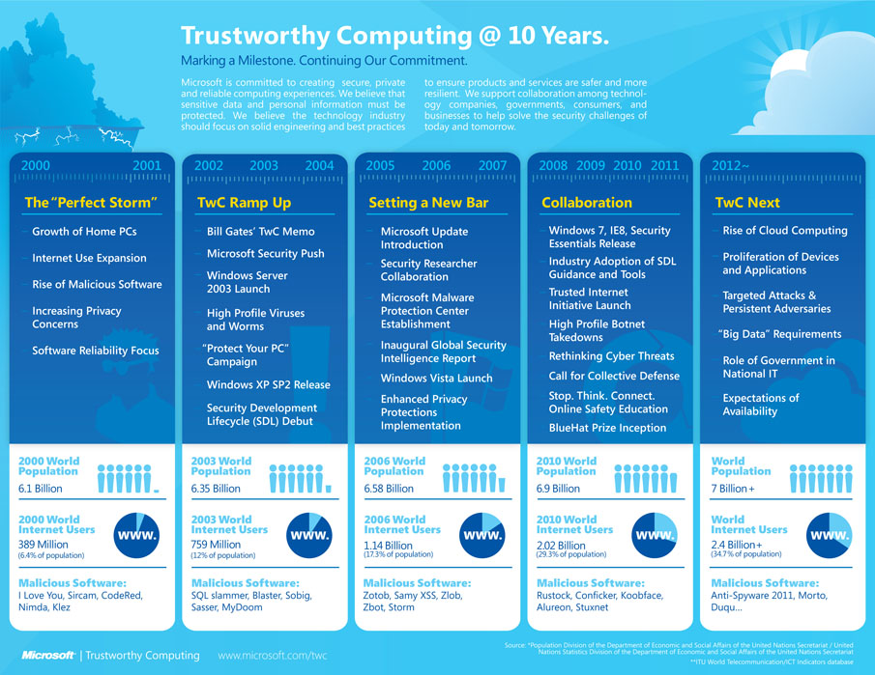
TwC Next Infographic

Slide 6
Microsoft Security Development Lifecycle (SDL)
A software development security assurance process
Training
Requirements
Design
Implementation
Verification
Release
Response
Video
Impacts on SQL Server 2005

Slide 7
Objectives of the Initiative
Objective | Description
Secure by design | - Eliminate any product vulnerability in the design phase
Secure by default | - Installs and configures the services and options actually in need
Secure in deployment | - Provide content so that DBAs can use appropriate security credentials in deployment
Secure in communications | Provides secure communication Use of Secure Sockets Layer (SSL) and certificates in new services implemented such as Service Broker and HTTP Endpoints

Slide 8
T-SQL (endpoints)
-- View the default system endpoints
select *
from sys.endpoints
where principal_id =1

Slide 9
Principle of Least Privilege (1)
Provide minimum access rights to a user to accomplish a task. This prevents privilege escalation attacks:
First, gain access to a basic level of privilege
Next, escalate the privilege for administrative rights
If an application is running with a low privilege, the damage from a security breach will be minimized
Incompatibility
Programs with an elevated privilege account may not run correctly

Slide 10
IBM Informix Data-level Privileges (example)
What is privilege in the context of database?
Three levels of database privileges
Connect Privilege
Can query and modify tables
Resource Privilege
Can create new, permanent tables, indexes, and stored procedures
DBA
Can grant database privileges
What about SQL Server privileges?

Slide 11
Principle of Least Privilege (2)
Feature | Description
A more granular permission schema | Assign only the permissions required to perform a particular task (e.g., run SQL Profiler w/ low privilege)
Metadata security | Metadata (e.g., a catalog view) are displayed only if a user has permissions
Schema assignment to specific users | Users can create schemas to group database objects and assign schema ownership only to those users who need it
Context switching | Can change execution context by impersonation

Slide 12
Principle of Least Privilege (3)
SQL Profiler
Location: Performance Tools -> SQL Server Profiler
Client-side utility that traces numerous events
select * from HumanResources.Employee
Context switching
Can execute statements as another login or another user without physically logging in as that principal
Use EXECUTE AS command for impersonation
Can impersonate a login or a user
Sysadmins grant IMPERSONATE permission
EXECUTE AS LOGIN = ‘login_new’
EXECUTE AS USER = ‘user_new’

Slide 13
Common Criteria for Information Technology Security Evaluation
Defines a set of valid security requirements for products and systems
“Driving force for the widest available mutual recognition of secure IT products”
Developed from criteria from different countries: ITSEC, TCSEC, CTCPEC
Common Criteria resolves the conceptual and technical differences existing in the source criteria.
Companies requires the certification to work with the U.S. government agencies
Vendors’ products are also evaluated based on the criteria - the implementation of certain security elements

Slide 14
Common Criteria
Consists of 60 security functional requirements in 11 classes
Enables evaluation of requirements using standards toward an Evaluation Assurance Level
See the attached for details
Helpful link

Slide 15
Advantages of Following Common Criteria
Vendors can support customers so that the system can be built more securely
Customers can examine the degree of fulfillment of the system using the criteria
Customers make use of security information for the implementation of the systems

Slide 16
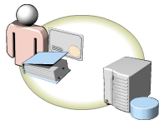
C2 Auditing Requirements
C2-level security
“A U.S. government rating for business software”
C2-compliance requirements defined by DoD:
User access control to a resource – require password
Protect system memory from being read after a process is finished. Use of a secure file system such as NTFS
Explicit user identification for auditable actions
Security-related events must be able to audit
The system protection from interference or tampering - modification of the application or system files

Slide 17
C2 Auditing in SQL Server
First, the OS that run SQL Server must be C2-compliant
The requirements for C2-compliant of SQL Server:
If a SQL Server component is not part of the evaluated configuration, disable it (e.g., SQL Mail, Analysis Services)
Only SQL Server system administrators can access SQL Server from the machine that runs the application
Use NTFS file system
Protect the physical network infrastructure

Slide 18
T-SQL (C2 audit mode)
-- How To Turn On C2 Audit Mode
sp_configure 'show advanced options', 0 ;
GO
RECONFIGURE ;
GO
sp_configure 'c2 audit mode', 1 ;
GO
RECONFIGURE ;
GO

Slide 19
Pop Quiz #1-3
Identify the standard created by Microsoft to make products secure to the highest level.
Which of the following features in SQL Server 2005 helps you to comply with the principle of least privilege?
Which of the following features must any C2-compliant software have?

Slide 20
- Benefits of a SQL Server Security Policy - Process of Creating a SQL Server Security Policy
Methodology for Designing a SQL Server Security Policy

Slide 21
Benefits of a SQL Server Security Policy
Security policies
Has guiding principles
Security policies define what to protect
Security procedures and standards
Provides the protection methodology
Database administrators
Audit databases and examine the usage of database objects according to security policies
Determine the impacts of the latest security vulnerabilities

Slide 22
Benefits of a SQL Server Security Policy
Benefit | Description
Preapproved security actions | Commitment to information security from an organization and its management
Reduced liability | The deployment of security practices help minimize liability after security breaches
Defined responsibility | Make employees responsible for security incidents
Checklist creation for the common operations in the policy | Can easily create checklists
Security framework | Provides an integrated and consistent security framework

Slide 23
Process of Creating a SQL Server Security Policy
Identify the most restrictive approach
Evaluate user impact
Identify exceptions
Obtain approvals
Plan
Do
Check
Act
Take measures to prevent and recover from attacks
Train users
Identify the current configurations and identify and eliminate any deviations
Identify regulatory reqmts
Ensure whether the security policy is working
Design an audit strategy

Slide 24
Benefits of a Secure-First Approach (Pop Quiz #4)
Classify each into a benefit / not a benefit category of a secure-first approach?

Slide 25
Pop Quiz #5-6
Which of the following are among the benefits of designing a SQL Server security policy?
Which of the following is the best approach to designing a SQL Server security policy?

Slide 26
- Why Monitor Security - Microsoft Auditing Tools - Microsoft Monitoring Tools - Selecting an Appropriate Tool
Monitoring SQL Server Security

Slide 27
Why Monitor Security?
Prevent security breaches
Understand application usage, users, server objects
Examine compliance with the security policy
What to monitor in SQL Server?
Logins, local group policy (incl. password), service accounts, objects (structure, permissions), login attempts

Slide 28
Microsoft Auditing Tools
Microsoft Baseline Security Analyzer
Evaluate the security status of the server
Find the missing hot fixes and patches
SQL Server Surface Area Configuration
enable or disable services as necessary
CLR (common language runtime) integration
OPENROWSET: allow ad-hoc queries to remote data sources
xp_cmdshell: run OS commands from database engine
SQL Server Internal Auditing
Dynamic management views (cf. Activity Monitor)
Database Console Commands (DBCC): check the physical and logical consistency of a database
System stored procedures

Slide 29
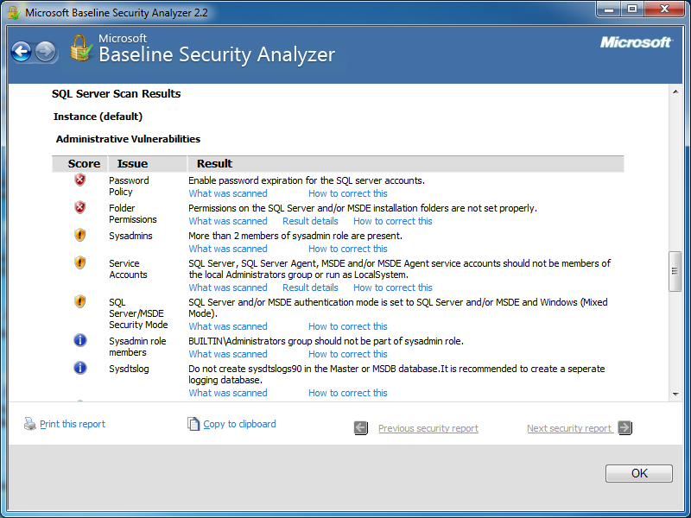
Microsoft Baseline Security Analyzer

Slide 30
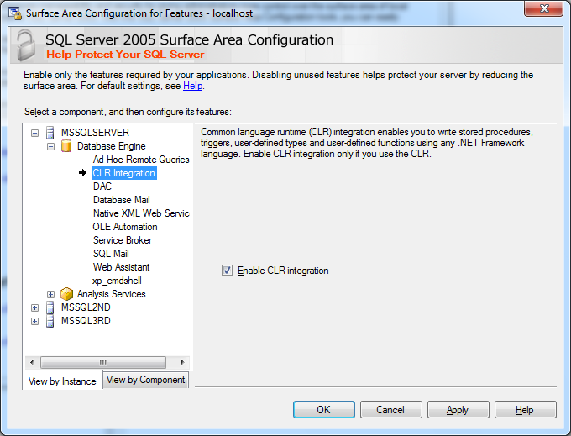
Surface Area Configuration for Features

Slide 31
Surface Area Configuration Examples
xp_cmdshell
EXEC xp_cmdshell 'dir *.exe';
GO
OPENROWSET

Slide 32
Microsoft Monitoring Tools
SQL Server Profiler
System Monitor (Sysmon)
Start -> Type “resource monitor”
SQL Server internal monitoring
sp_trace_create
sp_trace_setevent
sp_trace_setfilter

Slide 33
Selecting an Appropriate Tool (Pop Quiz #7)
The followings list the features and uses of different auditing and monitoring tools. Identify the appropriate tool from the three candidates: MBSA, SQL Server SAC, and SQL Server Profiler.

Slide 34
Pop Quiz #8-10
Identify the auditing tool that lists all the features enabled on a server at a given time.
As a database administrator, which of the following monitoring tools do you use to create your own events to trace?
Which one of the following tools connects to the Microsoft Web site and downloads an XML file that contains the entire list of hotfixes?

Slide 35
Summary
Principles of Database Security
Methodology for Designing a SQL Server Security Policy
Monitoring SQL Server Security

Slide 36
Next Week
Operating System Security
Laptop required
Assignment #3
Survey #2

